Slide 2


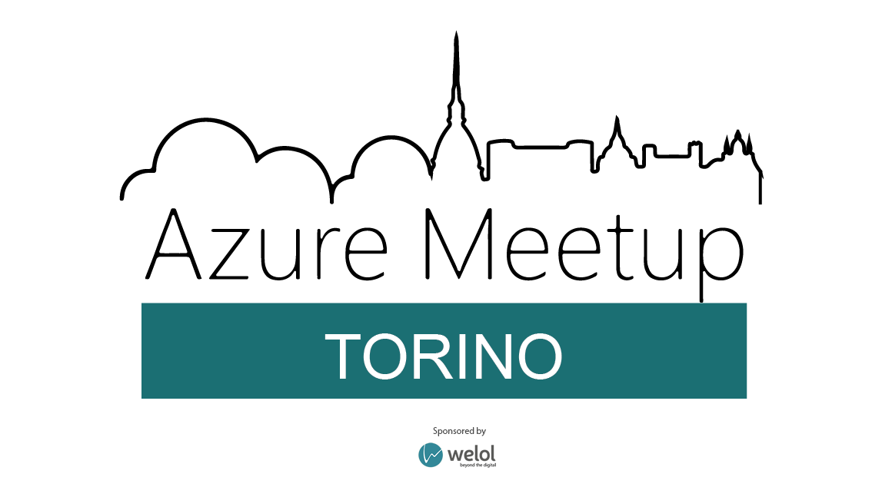



organizzato da

Slide 3









GLOBAL TECHNICAL SPONSOR

Slide 4
API Gateway made easy with Ocelot and Containers
Roberto Freato – Consultant / Author / Solution Architect

Slide 5
Building APIs
Common pitfalls:
«we already have an API, just expose it to the public»
«we are developing a new API, think about it as it would be the most complete and broader one»
«we split our platform into several micro-services/apis, but with common libraries and common design patterns»
«in case we need a new API, we will upgrade the existing clients to use the new version»
Instead:
«we already have an API, protect it behind a revese proxy to plug additional logic before clients reach it»
«we are developing a new API, with the assumption it would change frequently in the (even short-term) future»
«we split out platform into serveral micro-services/apis, and each service will follow its own guidelines to be completely independent»
«in case we need a new API, we will create a new version keeping the client un-aware of it»

Slide 6
Common Features
Reverse proxy – Routing
Logging, Monitoring and Analytics
Errors management
Documentation and API Portal
Traffic Management
Authentication
UI Composition / Aggregation
Transformation
API Lifecycle / environments
Caching and acceleration

Slide 7
API Gateways
Commercial products:
Apigee (Google)
Layer 7 (CA Api Gateway)
WSO2
MuleSoft
AWS API Gateway
Azure API Management
Axway
Open source alternatives

Slide 8
Ocelot
.NET Core API Gateway
https://github.com/ThreeMammals/Ocelot

Slide 9
Getting started
Scenario presentation and basic route-only implementation

Slide 10
Learned
Ocelot delivered as NuGet package
Needs:
«ocelot.json» configuration file
Basic declarations
Basic route
Redirection issues

Slide 11
Proxying APIs
Proxying Customers and Sales api with version-aware paths

Slide 12
Learned
Versioning with url prefix (alternatives?)
SSL termination is good
Routes can be overlapping (with priorities)

Slide 13
ViewModel composition
Aggregate requests and project the client-optimized model

Slide 14
Learned
Define dedicated paths for aggregation
Use custom aggregation functions
Minor fixes with headers transformation

Slide 15
Throttling
Traffic limiting under certain conditions

Slide 16
Learned
Very basic throttling features
Client-dependent feature (header)
Relate to Authorization header (with limitations)

Slide 17
Extensions
Extend Ocelot from outside (without pull requests)

Slide 18
Learned
Simple DI-based configuration extension
Makes the API Gateway stateless
Not so easy to extend/modify the pipeline

Slide 19
Containerization
Azure App Service for Containers - PaaS

Slide 20
Staging/Production
Using the Gateway to discriminate environments

Slide 21
Learned
Integrated with fully-managed Container Registry
Shared, managed machine pool
Single or multiple container support (with limitations)

Slide 22
Learned
Integration of App Service with custom DNS
Ocelot host-header-based routing

Slide 23
API Gateway made easy with Ocelot and Containers
Roberto Freato – Consultant / Author / Solution Architect
DEMOS and Slides available on GitHub:
https://github.com/childotg/Events.2019

